Slide 1
How Hard Does Mutation Analysis Have to be Anyway?
Rahul Gopinath Iftekhar Ahmed Amin Alipour Carlos Jensen Alex Groce
Notes:
Hello, I am Rahul Gopinath, PhD Candidate at Oregon State University. I am here to talk about our surprising result on mutation sampling. For those of you who were here yesterday for the talk on test case prioritization, you might have realized that mutation analysis is really expensive.
We have a solution.

Slide 2
Mutation analysis is a way of evaluating test suite adequacy, which is expensive. Our work is on determining how to accurately approximate mutation score cheaply. Spoiler: You only need 1,000 mutants for accurate mutation analysis irrespective of size of the program.
What this talk is about
Notes:
This talk is about mutation analysis which is a way of evaluating the adequacy of test suits.
A lot of work has been done on mutation analysis, and our work is on determining how expensive mutation analysis have to be.
As a spoiler, I am going to show you that for most programs, all you need to do is sample a 1000 random mutants from your program, and that will give you a very good approximation of the true mutation score. This is important as it can bring down the cost of mutation analysis tremendously.

Slide 3
Motivation
Programs are buggy.
public static int binarySearch(int[] a, int key) {
int low = 0;
int high = a.length - 1;
while (low <= high) {
int mid = (low + high) / 2;
int midVal = a[mid];
if (midVal < key)
low = mid + 1
else if (midVal > key)
high = mid - 1;
else
return mid; // key found
}
return -(low + 1); // key not found.
}
Binary search from Java.util.Arrays
Even simple short well-known programs can hide bugs.
Notes:
One of the key concerns of software engineering is to maintain the quality of programs.
If you doubt it is an issue, here is an old version of binary search from JDK.

Slide 4
Motivation
Programs are buggy.
public static int binarySearch(int[] a, int key) {
int low = 0;
int high = a.length - 1;
while (low <= high) {
int mid = (low + high) / 2;
int midVal = a[mid];
if (midVal < key)
low = mid + 1
else if (midVal > key)
high = mid - 1;
else
return mid; // key found
}
return -(low + 1); // key not found.
}
Binary search from Java.util.Arrays (Found 2006)
public static int binarySearch(int[] a, int key) {
int low = 0;
int high = a.length - 1;
while (low <= high) {
int mid = low + ((high - low) / 2);
int midVal = a[mid];
if (midVal < key)
low = mid + 1
else if (midVal > key)
high = mid - 1;
else
return mid; // key found
}
return -(low + 1); // key not found.
}
Fix
So we rely on our tests
Notes:
The problem is a trivial overflow in addition. It passed through multiple layers of verification until the bug was discovered.
Surprisingly the buggy version was even proved correct!
What this means is that, we have to rely on testing to ensure the quality of our programs.

Slide 5

Motivation
Rely on coverage to make sure our tests are good enough [gopinath-icse14]?
How do we know our tests are good enough?
Depends completely on how good your assertions are[zhang-fse15]
Up to 65% unit tests in OSS Projects sampled have inadequate asserts[zhi-issta13]
So : How do we test our tests?
Notes:
However, that just shifts the problem to another level.
How do we ensure the quality of our tests? They too are programs written by us, subject to the same mistakes.
We could for instance rely on the coverage measures. However, the efficacy of these measures depends completely on how good the assertions are. Unfortunately, up to 65% of assertions are inadequate in real world tests.
So the problem remains, how do we know our tests are good enough?

Slide 6

What is mutation analysis?
Generates fake bugs that looks like the real thing.
Used in the industry as a stopping criteria for test suites
Used by researchers to generate real looking faults, and hence judge the effectiveness of testing techniques.
Researchers have shown that mutants are similar to bugs [just2014], and their detectability is similar to real faults [andrews2005] and tests with high mutation score is better able to detect hand seeded faults [le2009] than other test coverage metrics.
?
Notes:
Mutation analysis is a technique used to compare test suites, and testing tools.
Researchers also use mutation analysis to evaluate how good their techniques
are in creating or modifying test suites.
The best way to judge the effectiveness of a test suite is to start with a known
set of faults, and see how many of the faults were caught by the suite. However,
this technique is rather hard to use in practice, as the programs we are concerned
with often do not have a known set of real faults, mostly because they have not
been caught yet.
Mutation analysis comes closest to this gold standard by providing an artificial set
of bugs against which the test suit is evaluated, and hence provides a metric
that can be used to evaluate a suite or a tool even in the absence of real faults.
Researchers have shown that the faults produced by mutation analysis are similar enough to real bugs that a test suite’s performance against the mutants is a reliable proxy against real faults.

Slide 7

How does it work?
We rarely know about all bugs in a code base.
Deterministically insert exhaustive first order faults against which test suites can be judged.
Δ=b² – 4ac
d = b^2 + 4 * a * c;
d = b^2 * 4 * a * c;
... etc.
Notes:
Because we rarely know how many bugs there are in the program before testing, it is hard to benchmark tools in the abstract.
So our best option is to introduce bugs in the code, and evaluate test suites on finding these.
That is, we use variants of the program with known defects that we can then use as metric.
However, there is an issue here, when we insert bugs, how do we know where to insert bugs?
Mutation analysis tackles this issue by introducing all first order faults into the code.

Slide 8
What are the problems with Mutation Analysis
The growth of mutants can often be super-linear over lines of code
The size of the test suite increases with the size of the program
The effort for mutation analysis is often quadratic.
Effort for mutation analysis
Mutation Points
Tests
Lines Of Code
Program Size
Program Size
Notes:
Mutation analysis is not the only option for judging the effectiveness of a test suite,
however, practitioners like this technique because it is directly related to the effectiveness of a test suite in finding faults in the code.
However, it comes with a catch. The bigger the program is, the more mutation points you have, and it results in a super linear growth in mutants.
The number of mutants produced is gargantuan even for small programs and test suites.
Considering that each mutant represents a potential full test run, the effort required is quadratic to the size of the program.

Slide 9
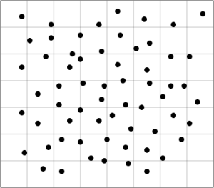
Sampling is your friend
But can we apply sampling?
Typical statistical sampling requires independence between mutants
So researchers have tried to empirically
determine the best sample size.
Notes:
From the very beginning of mutation analysis, when faced with a large number of mutants, people have always taken it for granted that we will have to do some sort of sampling.
However, the problem is that mutants are often very similar to each other. Statistical measures traditionally require independence of random variables before they can be used, and in the case of mutants, one really cant pretend they are independent because most mutants are really really similar.
However, that just means that traditional statistical measures are not usable. This has not stopped researchers from empirically estimating how much sampling is reasonable.

Slide 10
Previous empirical research
Sample size = N * 0.05
for 99% accuracy
[Zhang 2013]
Sample size = 34.0318 * N^{(-0.9390)}
(0.54% to 3.40% for 10,000)
for 99% accuracy
[Zhang 2014]
Sample Size
Sample Size
Mutants
Mutants
Notes:
For example Zhang et al. at ASE 2013 suggests 5% of the population is a reasonable sample size for a 99% accuracy. A very recent paper in the last ISSRE by Zhang et al. suggested that the required sample size growth is sub-linear, but still a function of mutant population.
The problem with this empirical analysis is two fold, for one, the growth is still linked to the size of mutant population. Secondly, we still didn’t know if the observed patterns would continue to higher numbers. Essentially, we do not know the underlying cause.

Slide 11
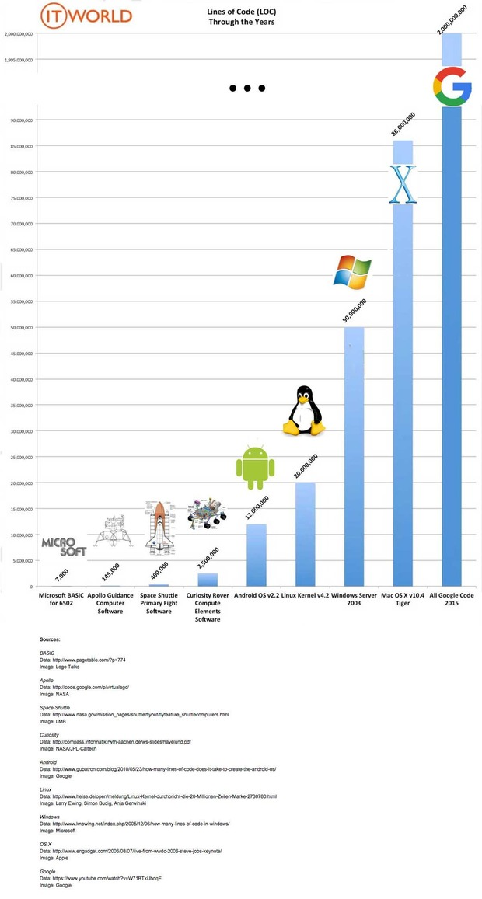
But even slow growth is painful
Google is 2 Billion Lines of Code
(© IT World)
Notes:
(pause)
Any growth function without a ceiling is bad. As the projects grow, the mutation requirements increase. Empirical research has been unable to identify a hard limit with the limited samples.

Slide 12
Research Goals
Is there a better limit for sample size?
Two ways to approach this question:
Empirical approach
Theoretical approach
Notes:
Our research goals were to find if there were a better limit or a ceiling for the sample size.
There are two ways we could approach this question. The first one as before, is to rely on the empirical studies, and analyze whether we can identify a better limit.
The other side of the coin is to find if mutation analysis can be evaluated from a theoretical view point, identifying the growth function, and upper limit – if any.

Slide 13
Methodology: Empirical study
Diverse sample of 1,800 Java Maven projects from Github
Removed aggregate projects resulting in 1,321 projects
Only 796 projects had test suites
Only 326 compiled with moderate effort
Only 158 non trivial projects with passing suites with moderate effort.
This sample was used to represent an average realistic project.
Projects had better test suites than most similar studies.
Notes:
For our empirical study, we sampled a large number of Java projects from Github which had a range of mutation scores, and reasonable non-trivial test suites.
As you can see, we started with a very large sample of 1800 projects, which was whittled down to 158 projects subject to various constraints.
Our subjects actually had better test suites than most similar studies.

Slide 14
Methodology: Empirical study
Used PIT (modified) to generate and run mutants.
Evaluated sampling accuracy using different stratifications
Program element
Operator
Both program element and operator
No stratification at all
Evaluated sampling accuracy with varying fractions of mutants.
Notes:
We evaluated the sampling accuracy using multiple stratifications – program element stratified, operator stratified and no stratification at all.
We evaluated different fractions of the mutants, determining the mean accuracy of approximation of the full mutation score and its variance.

Slide 15
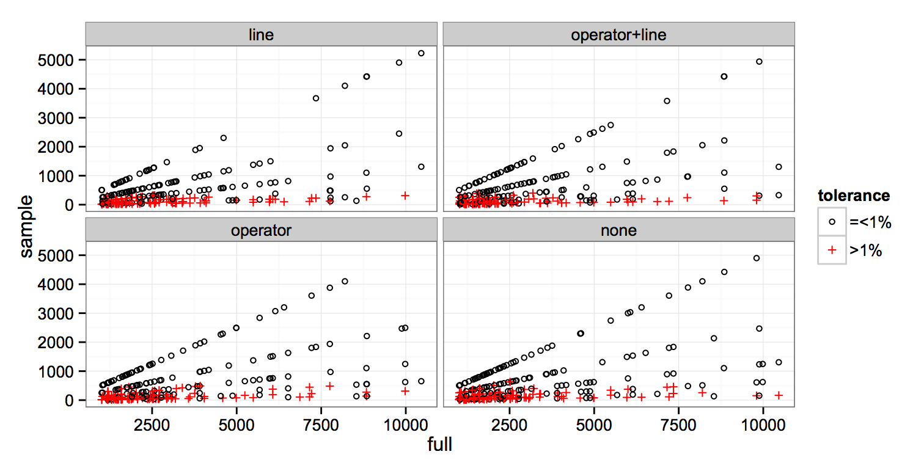
Our result: Empirically
﻿
Just 1,000 mutants are sufficient for 99% accuracy in most real world mutant populations
Notes:
Here, we have the mutant population on the X axis for 158 open source projects, and on the Y axis, we have the sample size that we checked.
The red crosses indicate the points where the accuracy of sampling was less than 99%.
The four graphs represent different stratifications, using x% mutants per line, x% per operator, using both, and using no stratification at all.
You can see that all the red marks are well below the blue lines representing 1,000 irrespective of the number of mutants.

Slide 16
Empirical vs. Theoretical
Is 1,000 mutants a hard limit, or a fluke of sampling?
Notes:
So is the 1,000 limit we see a hard limit? That requires theoretical analysis.

Slide 17
Statistical Assumptions
The assumptions we can not make about mutants
Mutants are independent
The assumptions that we can make about mutants
Mutants are very similar to each other
The number of mutants involved are very large.
Notes:
For theory, we know that we can not assume that mutants were independent.
Hence our only assumptions were that mutants were similar to each other, which is well established due to research in redundant mutants, and that the population of mutants were very large – at least large enough to require sampling.

Slide 18
Sampling theory
Variance of mutants = Variance of individual mutants
+ Covariance between mutant pairs
Accuracy of approximation depends on the variance.
We underestimate the accuracy of approximation when mutants are similar, leading to overestimation of sample size.
With positive covariance, the sampling required is smaller than with independence between mutants.
Notes:
Theoretically, we found that with similar mutants, the sampling required is smaller than when the mutants are completely independent.
Accuracy of approximation depends on the variance. We underestimate the accuracy of approximation when mutants are similar, leading to overestimation of the number of mutants involved.
That is, using sampling theory, we can estimate the ceiling of sample size for independent mutants, which will actually be an over estimation when real world mutants are considered.

Slide 19
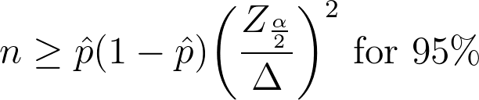
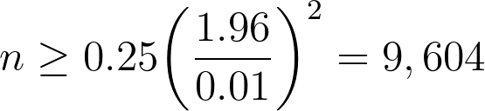
Our Result: Theoretically
The similarity between mutants results in lesser required sample size than independent mutants.
Theoretically, ~10,000 mutants are sufficient for 99% accuracy
Irrespective of the total number of mutants
That is
Notes:
Sampling theory suggests the limit for a large population of mutants under independence to be 9,604 (99% accuracy for 95% of samples)

Slide 20
Our Result: Theoretically
The similarity between mutants results in lesser required sample size than independent mutants.
Theoretically, ~10,000 mutants are sufficient for 99% accuracy
Irrespective of the total number of mutants
Sample Size
Mutants
Sample size no longer dependent on mutant population!
Notes:
That is, theoretically we only need roughly 10,000 mutants for sampling with 99% accuracy, irrespective of the population size.

Slide 21
Why the gap between theory and practice?
For theory, we assumed the worst case scenario for the limit
Independence (in comparison to similar mutants)
But in the real world, mutants are often very similar
A mutation score near 50% is harder to accurately estimate than a score near 1% or 99%
The scores of individual projects are much more widely distributed.
The real world is often more forgiving than the theory!
Notes:
There is a reason for the discrepancy between theory and practice.
For theory, we assumed the worst case scenario, which is that mutants are independent of each other. However, in the real world, the mutants are often very similar, leading to much lower sampling requirements.
Secondly, the sampling theory suggests that the accuracy is worst near 50% mutation score. However, in the real world, the scores are much more widely distributed.
That is, the real world is often more forgiving than the theory!

Slide 22
So, how hard is mutation analysis?
Not all tests need to run – only tests that cover the mutant
While test suites grow large, the average number of unit tests that target a program element stays relatively the same.
Effort for mutation analysis
Mutation Points
Tests
Lines Of Code
Program Size
Program Size
Notes:
So considering mutation analysis again, we already know that only the tests that cover a selected mutant needs to be run. These tests are often written to target the particular program unit in question, and their number tends to stay the same with increase in program size.

Slide 23
So, how hard is mutation analysis?
Not all tests need to run – only tests that cover the mutant
While test suites grow large, the average number of unit tests that target a program element stays relatively the same.
Effort for mutation analysis
Mutation Points
Tests
Lines Of Code
Program Size
Program Size
Notes:
So what this effectively means is that once we have the test suite coverage,

Slide 24
So, how hard is mutation analysis?
Not all tests need to run – only tests that cover the mutant
While test suites grow large, the average number of unit tests that target a program element stays relatively the same.
Mutation Points
Tests
Effort for mutation analysis
Single test suite run for coverage
Lines Of Code
Program Size
Program Size
Notes:
The effort required for mutation analysis is some constant overhead irrespective of the size of the program.

Slide 25
Conclusion
Mutation analysis is not hard.
Accurately estimate mutation score with just 1,000 mutants for real world test suites.
Incorporate mutation analysis of your test suite for you continuous builds.
Notes:
To recap:
The main message I have is that, mutation analysis using n-sampling is surprisingly easy, and can be done in as few as 1000 mutants.
This means that testers can take advantage of mutation analysis to ensure that their tests are high quality during development.

Slide 26


Problems with mutation analysis
Evaluating equivalent mutants is really hard, researchers often just declare the remaining non-killed mutants equivalent.
This effectively means that practitioners consider traditional mutation analysis to be “Just a theoretical tool” unusable for every day testing.
Notes:
Equivalent mutants are caused by syntactic differences that do not result in a fault. The problem with equivalent mutants is that a general way to distinguish them from actual faults is impossible.
These problems effectively mean that Mutation Analysis is often consigned to the “too theoretical to be of use” bin.
(pause)

Slide 27
Equivalent mutants
Input domain of functions have similar characteristics.
Why does this matter? (why does equivalents matter)
Sampling 10,000 inputs is sufficient to guarantee that a mutant does not differ from original by more than 1%. ??? This is not what it means is it???
Provides upper bound on effort required for distinguishing equivalent mutants
Notes:
The same reasoning can be applied to equivalent mutants. We can use 10,000 random inputs to verify that a mutant is either dissimilar or not to the original program by 1% of its input domain. Of course if a mutant is different from the original even by a single input, it is still buggy. However, we know from the random testing research that a significant number of faults have patterns in input domain where the effects are manifest. So evaluating equivalent mutants this way should at least identify those faults.

